Slide 1


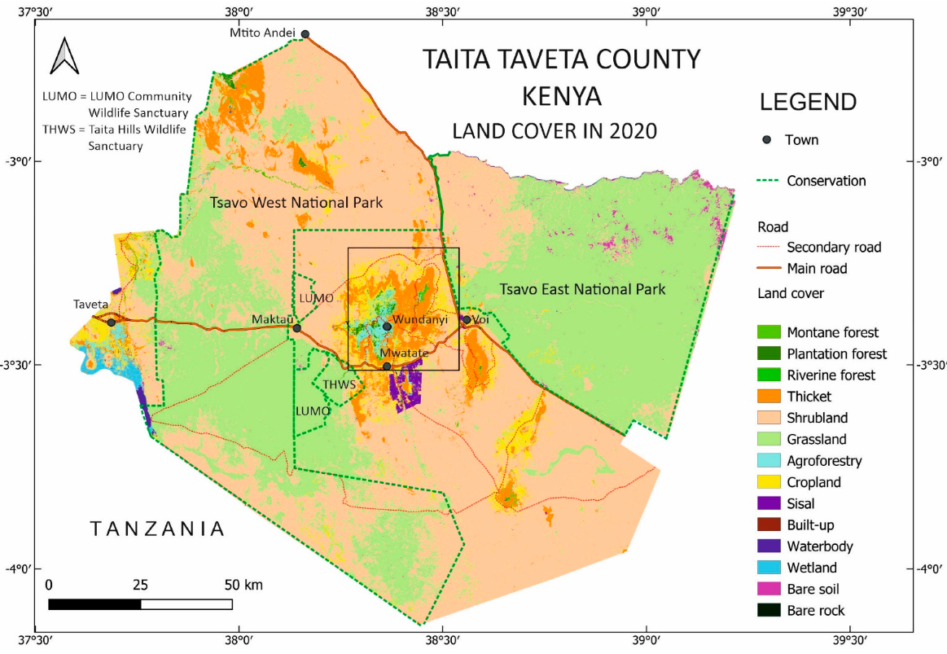



Strengthening Diagnostic Response to Climate-Related Health Risks in Taita Taveta County, Kenya: A One Health Scoping Review
Clara Andala¹, Dennis Moka² Dr. Ivy Wanjiru³ Nancy Adala⁴, Jacinta Muthoka⁵
¹Wesu Sub County Hospital – Laboratory Epidemiologist
²Wundanyi Sub County Laboratory Coordinator
³Wesu Sub County Hospital- Pharmacist
⁴Kenya Power and Lighting Company- Environment and Safety Officer
⁵Independent Consultant-Meteorological Department
BACKGROUND
The ecology of diseases that are transmitted in sub-Saharan Africa is being redefined by climate variability, and it affects the arid and semi-arid lands (ASALs) unevenly. Taita Taveta County is typified by a high degree of ecological heterogeneity of high-altitude Taita Hills to irrigated borderlands and semi-arid lowlands. This translates into differentiated sub-county susceptibility to the effect of vector-borne, waterborne, zoonotic, nutritional, respiratory, and heat diseases. Despite the increasing climate shocks, preparation to diagnostic has not been appropriately specified, at the sub-county level.
OBJECTIVE: : To identify the pattern of climate-sensitive disease trends and diagnostic capacity gaps in Wundanyi, Mwatate, Voi, and Taveta sub-counties. .
METHODOLOGY: The scope review focused on reviewing peer-reviewed resources, international climate-health literature, national and county policy frameworks, and recent (2025/2026) sub-county epidemiologic rates. The evidence was interpreted on a One Health framework.
STUDY AREA: Taita Taveta County, Kenya
DISCUSSION
Commit to a sub-county differentiated and stratified diagnostic planning for the four sub-counties
Wundanyi (Highland zone): Establish arboviral and highland malaria monitoring, introduce landslide-related outbreak monitoring and enhance the diagnostics of the respiratory infections in cold/damp seasons.
Mwatate (Transitional urban hub): Molecular validation of waterborne disease, urban sanitation surveillance assimilation, and post heavy rainfall enhancement of the vector surveillance.
Voi (ASAL lowlands): Priority should be put on drought heat disease surveillance, malaria vectors and zoonotic early warning systems that are combined with mobile outreach diagnostics.
Taveta (Irrigated borderland): Build on annual malaria molecular surveillance, integrate irrigation related mapping of all vector habitats and strengthen cross country outbreak reporting with Tanzania.
RESULTS
CONCLUSIONS
Disease patterns are changing due to increased temperature, unpredictable bimodal precipitations, drought-floods, deforestation, and the expansion and migration of people across borders. Highland warming in Wundanyi promotes malaria and arboviral growth. Cholera, typhoid, respiratory disease and zoonotic threat is more active in semi-arid Mwatate and Voi, while malaria is common in irrigated Taveta with increasing arboviral and filarial vulnerability. The largest proportion of outpatient diagnoses has been Upper Respiratory Tract Infection (69%), skin infections (12%), and diarrheal diseases (5%) as per the County surveillance data (2025/2026).
Majority of the diagnostic systems remain much dependent on microscopy and rapid-test-based diagnostic systems with minimal decentralized molecular capacity and human-animal-environmental surveillance. Climatic change in Taita Taveta County is not a future speculation, but a present-day epidemiological phenomenon that is changing the disease patterns along ecological gradients. Taita Taveta provides the scales of climate-adaptive diagnostics in ecological diversity on the African continent. We recommend geographically decentralizing diagnostic capabilities, increasing One Health-surveillance, strengthening climate-predicted modelling and workforce development.
Contact Email: cmuyaku@gmail.com

Slide 2
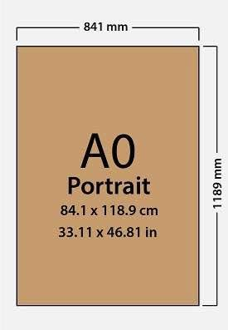
Poster Size Guideline

